Slide 1
Severstal Steel Defect Detection
City College of Engineering
Deep Learning course
Group members:
Carlos
Deepak
Divya
Sonali

Slide 2
Objective:
.
Predict the location and type of defects found in steel manufacturing using the images provided.
The images are named with a unique ImageId,
Goal:
To segment each image and classify the defects in the test set
There are 12568 images in the train set.
There are 5506 images in the test set

Slide 3
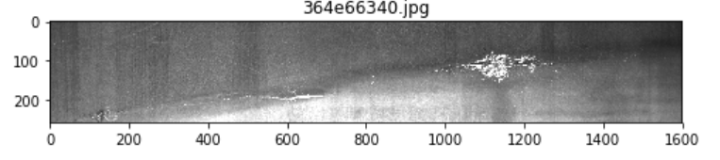
Methods:
EDA
Segmentation
Binary Classification with CNN
Multi class classification with Resnet
Object detection with Unet

Slide 4
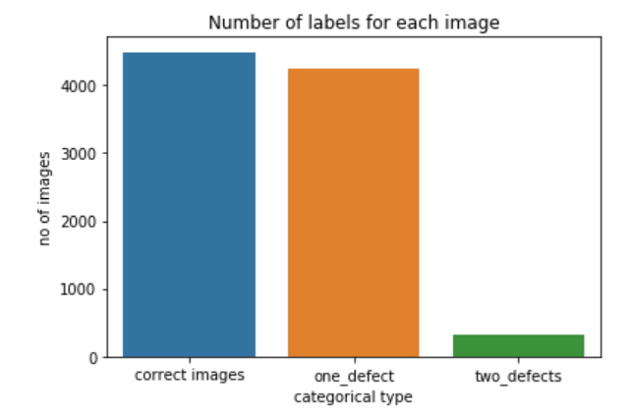
EDA for binary classification
Almost half of images doesn't contain any defects
Most of images with defects contain the defects of only one type;
In rare cases an image contains the defects of two different types

Slide 5
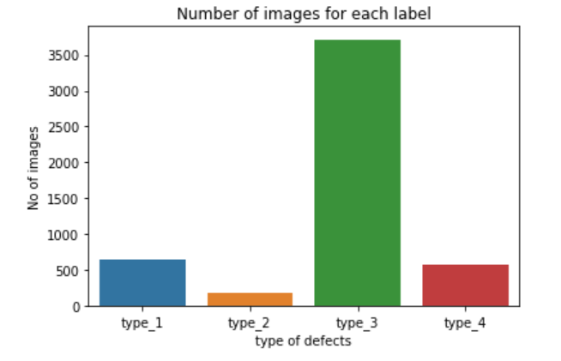
EDA for multiclass classification
The dataset is very imbalanced.
Data augmentation
resampling techniques will
be required to perform the defect detection

Slide 6
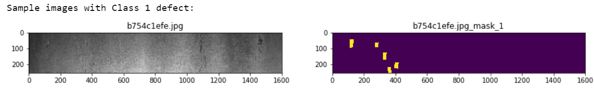
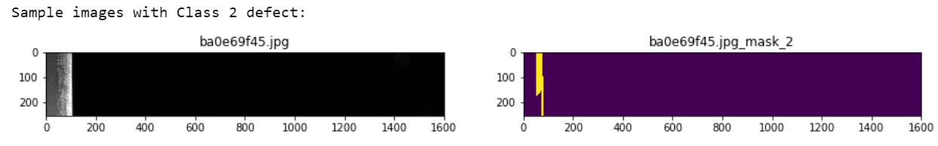
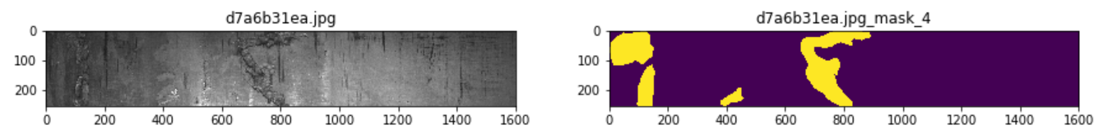
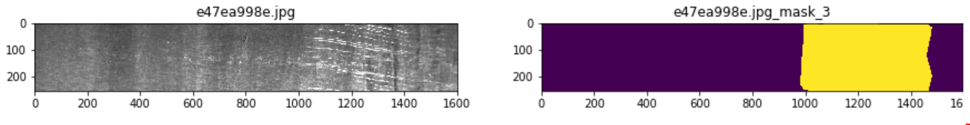
Segmentation

Slide 7
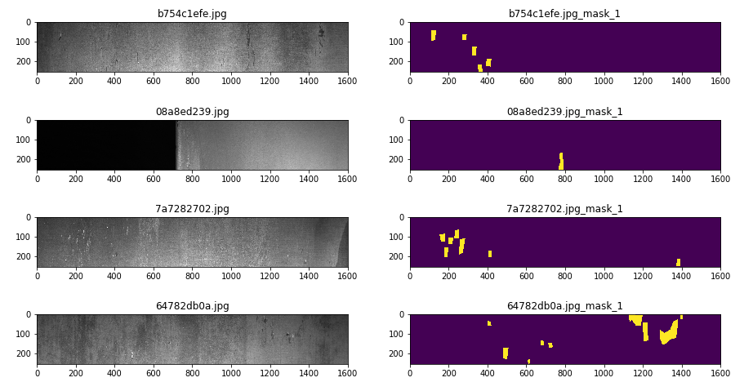
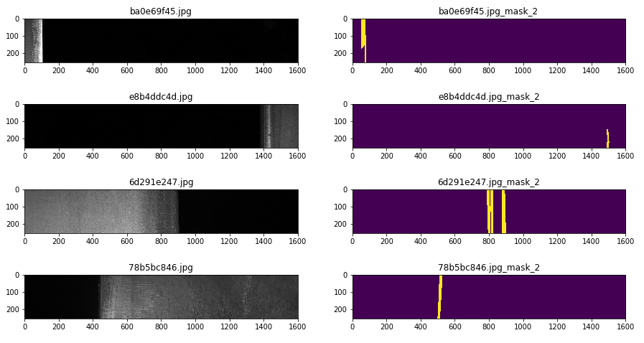
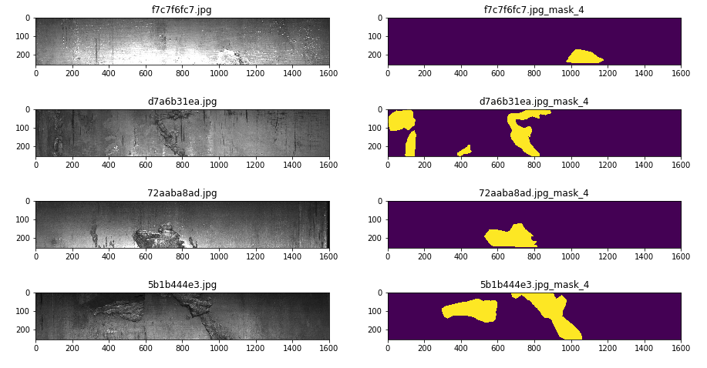
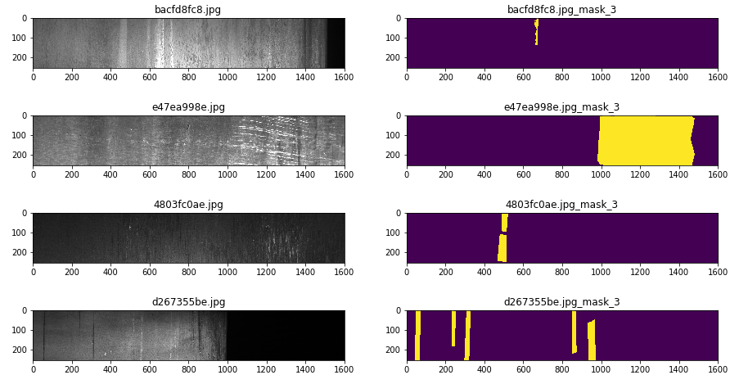
Segmentation
Type 1 defects
Type 2 defects
Type 4 defects
Type 3 defects

Slide 8
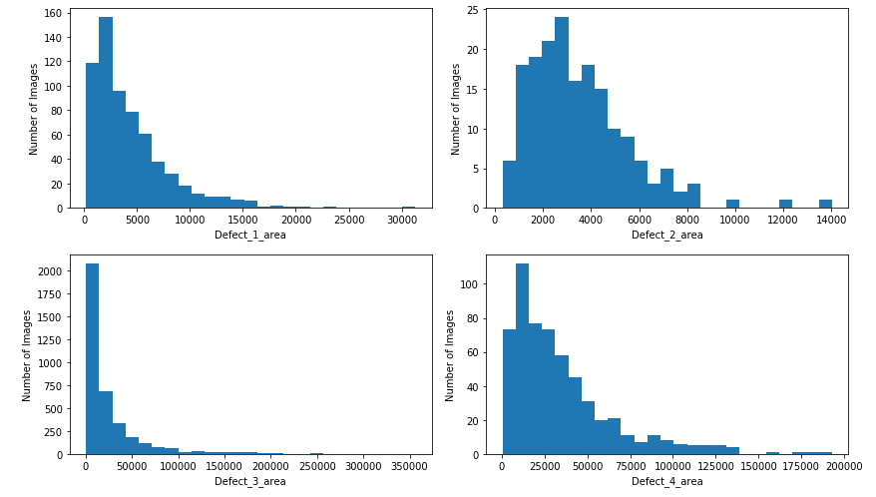
Area masking

